Slide 1



PROGRESS REPORT
DISTRICT –
REGION
, 2023

Slide 2
District Overview
Taluka | Category | No. of Schemes |  | Work Order Issued |  | Work In Progress |  | Work Not Started
 |  | PMC | TSP | PMC | TSP | PMC | TSP | PMC | TSP
Akola | Retro | 21 | 0 | 21 | 0 | 19 | 0 | 2 | 0
 | New | 4 | 0 | 4 | 0 | 2 | 0 | 2 | 0
Balapur | Retro | 13 | 2 | 13 | 2 | 12 | 0 | 1 | 2
 | New | 1 | 0 | 1 | 0 | 0 | 0 | 1 | 0
Barshitakali | Retro | 43 | 0 | 43 | 0 | 40 | 0 | 3 | 0
 | New | 13 | 0 | 13 | 0 | 8 | 0 | 5 | 0
Murtizapur | Retro | 22 | 0 | 22 | 0 | 21 | 0 | 1 | 0
 | New | 7 | 0 | 7 | 0 | 6 | 0 | 1 | 0
Patur | Retro | 30 | 14 | 30 | 14 | 27 | 11 | 3 | 3
 | New | 6 | 0 | 6 | 0 | 5 | 0 | 1 | 0
Total | Retro | 129 | 16 | 129 | 16 | 119 | 11 | 10 | 5
 | New | 31 | 0 | 31 | 0 | 21 | 0 | 10 | 0
Grand Total |  | 160 | 16 | 160 | 16 | 140 | 11 | 20 | 5
 |  | 176 |  | 176 |  | 151 |  | 25

Slide 3
Executive Summary Work in Progress Schemes
Taluka | Category | No. of Schemes | No. of Schemes based on Physical Progress %
 |  |  | < 25% | 25 < 50% | 50 < 75% | 75 < 100% | Commissioned
Akola | Retro | 19 | 14 | 1 | 1 | 3 | 0
 | New | 2 | 2 | 0 | 0 | 0 | 0
Balapur | Retro | 12 | 10 | 2 | 0 | 0 | 0
 | New | 0 | 0 | 0 | 0 | 0 | 0
Barshitakali | Retro | 40 | 22 | 15 | 3 | 0 | 0
 | New | 8 | 8 | 0 | 0 | 0 | 0
Murtizapur | Retro | 21 | 18 | 2 | 0 | 1 | 0
 | New | 6 | 5 | 1 | 0 | 0 | 0
Patur | Retro | 38 | 21 | 8 | 5 | 4 | 0
 | New | 5 | 3 | 1 | 0 | 1 | 0
Total | Retro | 130 | 85 | 28 | 9 | 8 | 0
 | New | 21 | 18 | 2 | 0 | 1 | 0
Grand Total |  | 151 | 103 | 30 | 9 | 9 | 0

Slide 4
Abstract of Schemes – Work in Progress Category – “Retro”
Sr No | Scheme Name | Name of Agency | W.O. Amount (excl GST) | W.O. Date | Construction Period | Physical Progress | RA Bill (Recommended) % | RA Bill (Recommended) In Lakhs
Akola Taluka | Akola Taluka
1 | Palso BK. | Gajanan Dattatrya Deshpande | 32,25,531 | 08-08-2022 | 6 Months | 99.97% | - | -
2 | Yavalkhed | Narendra Gopalrao Sure | 31,86,717 | 26-07-2022 | 9 Months | 90.49% | - | -
3 | Yeota | Narendra Gopalrao Sure | 44,47,610 | 26-07-2022 | 9 Months | 88.86% | - | -
4 | Kumbhari | Narendra Gopalrao Sure | 1,55,05,598 | 29-11-2022 | 9 Months | 72.57% | - | -
5 | Kapshi Road | Narendra Gopalrao Sure | 1,13,52,145 | 12-05-2022 | 9 Months | 28.23% | - | -
6 | Patur Nandapur | Vasant Subhashrao Deshmukh | 1,61,20,122 | 15-12-2022 | 9 Months | 20.99% | 15.43% | 24.87
7 | Washimba | Sanjay Ambadas Thakur | 66,38,419 | 09-07-2022 | 9 Months | 19.94% | - | -
8 | Katyar | Gajanan Dattatreya Deshpande | 73,31,733 | 13-09-2022 | 9 Months | 7.84% | - | -
9 | Sisa Bondarkhed | Manoj S. Korpe | 34,86,117 | 14-07-2022 | 9 Months | 2.84% | - | -
10 | Dewali | Vasant Subashrao Deshmukh | 64,90,750 | 08-05-2022 | 9 Months | 2.27% | - | -
11 | Dongargaon | Vasant Subashrao Deshmukh | 1,02,98,981 | 27-06-2022 | 9 Months | 1.28% | - | -
12 | Dalambi | Mohan G. kakar (Sharma) | 1,26,10,848 | 08-10-2022 | 9 Months | 1.03% | - | -
13 | Khadaka | Vishal Shantaram Kakad | 57,74,643 | 15-12-2022 | 9 Months | 0.92% | - | -

Slide 5
Abstract of Schemes – Work in Progress Category – “Retro”
Sr No | Scheme Name | Name of Agency | W.O. Amount (excl GST) | W.O. Date | Construction Period | Physical Progress | RA Bill (Recommended) % | RA Bill (Recommended) In Lakhs
14 | Kolambi | Narendra Gopal Rao Sure | 75,54,603 | 26-07-2022 | 9 Months | 0.75% | - | -
15 | Sonala | Gopal Shaligram Gawande | 44,35,166 | 07-04-2022 | 9 Months | 0.74% | - | -
16 | Chikhalgaon | Mohan G. Kakar | 32,09,262 | 19-08-2022 | 6 Months | 0.71% | - | -
17 | Sisa Udegaon | Rajesh Gulabrao Ghule | 22,25,464 | 29-07-2022 | 6 Months | 0.66% | - | -
18 | Chachondi | Gopal Shaligram Gawande | 32,89,558 | 09-09-2022 | 9 Months | 0.41% | - | -
19 | Takli Pote | Narendra Gopalrao Sure | 55,37,981 | 12-05-2022 | 9 Months | 0.24% | - | -
Balapur Taluka | Balapur Taluka
20 | Mandawa Bk. | Gopal Bhimrao Bhagat | 25,14,377 | 13-08-2022 | 9 Months | 40.32% | - | -
21 | Tamshi | Vasant Subashrao Deshmukh | 75,40,741 | 15-12-2022 | 9 Months | 30.53% | - | -
22 | Batwadi Bk. & Kh. | Vasantrao Subashrao Deshmukh | 2,25,35,477 | 15-12-2022 | 9 Months | 13.08% | - | -
23 | Dhanegaon | Rahul Dhanokar | 15,63,449 | 12-12-2022 | 6 Months | 13.04% | - | -
24 | Chincholi Ganu | Manoj S Korpe | 1,03,02,685 | 24-07-2022 | 9 Months | 2.61% | - | -
25 | Manki | Sanjay Madhukar Gadghe | 92,80,074 | 15-12-2022 | 9 Months | 1.54% | - | -
26 | Hingna (Shelad) | Mangesh Trambyak Mahalle | 62,42,297 | 15-12-2022 | 9 Months | 1.41% | - | -

Slide 6
Abstract of Schemes – Work in Progress Category – “Retro”
Sr No | Scheme Name | Name of Agency | W.O. Amount (excl GST) | W.O. Date | Construction Period | Physical Progress | RA Bill (Recommended) % | RA Bill (Recommended) In Lakhs
27 | Khamkhed | Vasant Subhashrao Deshmukh | 63,00,519 | 26-05-2022 | 6 Months | 1.27% | - | -
28 | Satargaon | Rahul Dhanokar | 68,25,420 | 14-12-2022 | 9 Months | 0.32% | - | -
29 | Balhadi | Sahyam Bhagawantrao Mahore | 69,25,325 | 29-11-2022 | 9 Months | 0.24% | - | -
30 | Barlinga | Deepak Govindrao Deshmukh | 68,77,822 | 15-12-2022 | 12 Months | 0.15% | - | -
31 | Pimpalgaon | Deepak Govindrao Deshmukh | 62,11,114 | 15-12-2022 | 9 Months | 0.14% | - | -
Barshitakli Taluka | Barshitakli Taluka
32 | Anjani | Narendra Gopalrao Sure | 81,12,305 | 08-12-2022 | 9 Months | 70.36% | 45.12% | 36.60
33 | Dhakali | Narendra Gopalrao Sure | 46,75,136 | 08-12-2022 | 9 Months | 58.20% | 47.59% | 22.25
34 | Sahit | Gajanan Dattatreya Deshpande | 56,52,905 | 23-06-2022 | 9 Months | 54.93% | - | -
35 | Nimbi | Narendra Gopalrao Sure | 53,65,719 | 13-12-2022 | 9 Months | 48.18% | 38.43% | 20.62
36 | Pimpalgaon Chambare | Gajanan Dattetarye Deshpande | 66,42,477 | 15-12-2022 | 9 Months | 44.77% | 43.62% | 28.97
37 | Morhal | Gajanan Dattatreya Deshpande | 55,15,516 | 23-06-2022 | 9 Months | 42.54% | 39.03% | 21.53
38 | Mozari Kh | Sadguru Constructions | 34,23,550 | 20-08-2022 | 9 Months | 41.00% | 37.33% | 12.78
39 | Nimbi Kh. | Gajanan Deshpande | 42,44,720 | 08-08-2022 | 6 Months | 38.78% | - | -

Slide 7
Abstract of Schemes – Work in Progress Category – “Retro”
Sr No | Scheme Name | Name of Agency | W.O. Amount (excl GST) | W.O. Date | Construction Period | Physical Progress | RA Bill (Recommended) % | RA Bill (Recommended) In Lakhs
40 | Ghota | Mohan G. Kakar | 82,17,793 | 27-11-2022 | 9 Months | 35.28% | 26.40% | 21.69
41 | Kasmar | Narendra Gopalrao Sure | 32,55,126 | 08-12-2022 | 9 Months | 34.43% | 31.52% | 10.26
42 | Mahagaon | Gajanan Dattatreya Deshpande | 41,52,289 | 12-05-2022 | 9 Months | 34.28% | - | -
43 | Redhawa | Shayam Bhagawant Mahore | 74,29,857 | 18-11-2022 | 9 Months | 33.88% | 29.94% | 22.24
44 | Loghad Tanda | Narendra Gopalrao Sure | 48,41,985 | 26-05-2022 | 9 Months | 31.28% | 12.96% | 6.28
45 | Nimbi Bk | Gajanan Dattatreya Deshpande | 45,09,471 | 12-05-2022 | 9 Months | 30.08% | - | -
46 | Parabhwani | Sunil U. Samdurkar | 58,48,123 | 14-12-2022 | 9 Months | 27.95% | - | -
47 | Donad Kh | Narendra Gopalrao Sure | 28,39,157 | 28-07-2022 | 9 Months | 26.33% | - | -
48 | Bormali | Dipak Govindrao Deshmukh | 38,25,259 | 14-07-2022 | 9 Months | 26.08% | - | -
49 | Devdari, Warkhed, Chincholi | Shayam Bhagawantrao Mahore | 86,09,032 | 24-11-2022 | 9 Months | 25.63% | 19.18% | 16.51
50 | Wagha Kh | Vishal Shantaram Kakad | 38,21,862 | 22-05-2022 | 9 Months | 24.44% | - | -
51 | Wastapur | Vishal Nagorao Dubole | 22,99,213 | 09-07-2022 | 9 Months | 22.88% | - | -
52 | Bhendi Mahal | Narendra Gopalrao Sure | 45,34,698 | 16-07-2022 | 9 Months | 21.30% | - | -
53 | Nimbhara | Narendra Gopalrao Sure | 24,57,533 | 12-05-2022 | 9 Months | 18.83% | 15.38% | 3.78

Slide 8
Abstract of Schemes – Work in Progress Category – “Retro”
Sr No | Scheme Name | Name of Agency | W.O. Amount (excl GST) | W.O. Date | Construction Period | Physical Progress | RA Bill (Recommended) % | RA Bill (Recommended) In Lakhs
54 | Sahapur | Vasant Subashrao Deshmukh | 33,52,221 | 15-12-2022 | 9 Months | 17.10% | - | -
55 | Songiri | Sanjay Madhukarrai Ghadge | 57,73,368 | 15-12-2022 | 9 Months | 12.17% | - | -
56 | Titwan | Narendra Gopalrao Sure | 85,36,468 | 15-12-2022 | 9 Months | 10.67% | - | -
57 | Kothali Kh | Ishwar Ramji Jadhav | 46,50,212 | 10-07-2022 | 9 Months | 10.51% | - | -
58 | Sevanagar (N.V) | Mangesh Trimbakrao mahale | 56,79,121 | 15-12-2022 | 9 Months | 9.58% | - | -
59 | Nihida-Lakhmapur | Gajanan Dattatrya Deshpande | 1,31,54,377 | 12-05-2022 | 9 Months | 8.69% | - | -
60 | Pardi mozari | Gajanan Deshpande | 40,31,539 | 07-07-2022 | 9 Months | 8.44% | - | -
61 | Kothali Bk | Sanjay Madhukarrao Ghadge | 63,16,644 | 08-08-2022 | 6 Months | 7.51% | - | -
62 | Wadgaon | Sanjay Ghadge | 50,46,752 | 15-12-2022 | 9 Months | 3.65% | - | -
63 | Dhanora | Vasantrao Subashrao Deshmukh | 36,02,638 | 15-12-2022 | 9 Months | 3.10% | - | -
64 | Chelka | Narendra Gopalrao Sure | 29,40,084 | 12-05-2022 | 9 Months | 3.00% | - | -
65 | Chichkhed / Kasarkhed | Mohan Kakar | 73,03,006 | 08-12-2022 | 9 Months | 0.75% | - | -
66 | Titawa | Gajanan Deshpande | 50,65,132 | 23-06-2022 | 9 Months | 0.48% | - | -
67 | Sawarkhed | Vishal Nagarao Dubole | 37,71,792 | 29-11-2022 | 9 Months | 0.25% | - | -

Slide 9
Abstract of Schemes – Work in Progress Category – “Retro”
Sr No | Scheme Name | Name of Agency | W.O. Amount (excl GST) | W.O. Date | Construction Period | Physical Progress | RA Bill (Recommended) % | RA Bill (Recommended) In Lakhs
68 | Jamkeshwar | Rajesh Gulabrao Ghule | 55,73,843 | 29-07-2022 | 9 Months | 0.25% | - | -
69 | Shelu Bk. | Rajesh Ghule | 56,70,820 | 15-12-2022 | 9 Months | 0.23% | - | -
70 | Hatola | Mohan G. Kakar (Sharma) | 1,10,96,757 | 27-11-2022 | 9 Months | 0.12% | - | -
71 | Umardari | Vishal Nagorao Dubole | 36,86,192 | 09-07-2022 | 9 Months | 0.10% | - | -
Murtizapur Taluka | Murtizapur Taluka
72 | Salatwada | Prakash V. Raut | 14,99,099 | 09-08-2022 | 9 Months | 83.49% | 82.95% | 12.44
73 | Sakhari | Gopal Baburao Gunjkar | 15,58,982 | 15-12-2022 | 6 Months | 31.94% | - | -
74 | Kawtha Sopinath | Narendra Gopalrao Sure | 45,73,501 | 12-07-2022 | 9 Months | 27.76% | 20.73% | 9.48
75 | Borgaon | Narendra Gopalrao Sure | 58,68,035 | 12-05-2022 | 9 Months | 24.37% | - | -
76 | Kharab Naole | Vishal Nagorao Dubole | 38,58,258 | 12-05-2022 | 9 Months | 19.27% | - | -
77 | Wadgaon Kurum | Deepak V. Shah | 56,01,503 | 24-11-2022 | 9 Months | 10.73% | - | -
78 | Kawhla | Narendra Gopalrao Sure | 30,46,604 | 12-07-2022 | 9 Months | 3.86% | - | -
79 | Shelu Wetal | Ratnadeep Janrao Apgad | 35,22,427 | 22-11-2022 | 9 Months | 2.88% | - | -
80 | Samsherpur | Mohan G. Kakar | 30,75,504 | 29-11-2022 | 9 Months | 2.62% | - | -

Slide 10
Abstract of Schemes – Work in Progress Category – “Retro”
Sr No | Scheme Name | Name of Agency | W.O. Amount (excl GST) | W.O. Date | Construction Period | Physical Progress | RA Bill (Recommended) % | RA Bill (Recommended) In Lakhs
81 | Aarkhed | Vivek Khanderao Tale | 39,35,384 | 15-12-2022 | 9 Months | 2.53% | - | -
82 | Dhanora Waidya | Suryakant Ashok Parkhi | 32,49,208 | 29-11-2022 | 9 Months | 2.47% | - | -
83 | Sherwadi | Rajesh Gulabrao Ghule | 45,73,337 | 15-12-2022 | 9 Months | 2.26% | - | -
84 | Goregaon | Narendra Gopalrao Sure | 29,15,188 | 15-12-2022 | 9 Months | 2.13% | - | -
85 | Rajura Sarode | VISHAL SHANTARAM KAKAD | 39,99,441 | 15-12-2022 | 9 Months | 2.01% | - | -
86 | Sonori ( Bopori ) | Narendra Gopalrao Sure | 29,84,184 | 15-12-2022 | 9 Months | 1.34% | - | -
87 | Shend | Gopal Babulal Gunjkar | 24,24,503 | 30-07-2022 | 6 Months | 1.21% | - | -
88 | Navsal | Shayam Bhagawantrao Mahore | 34,42,415 | 29-11-2022 | 9 Months | 1.06% | - | -
89 | Takli Gajipur | Narendra Gopalrao Sure | 71,03,352 | 15-12-2022 | 9 Months | 0.58% | - | -
90 | Kinhi | Vivek Khanderao Tale | 32,90,705 | 15-12-2022 | 9 Months | 0.37% | - | -
91 | Bhagora | Gopal Shaligram Gawande | 47,04,578 | 12-07-2022 | 9 Months | 0.37% | - | -
92 | Bapori | Narendra Gopalrao Sure | 41,73,083 | 26-07-2022 | 9 Months | 0.22% | - | -
Patur Taluka | Patur Taluka
93 | Asola | Mohan G. Kakar | 37,39,683 | 08-08-2022 | 6 Months | 97.65% | 30.42% | 11.38

Slide 11
Abstract of Schemes – Work in Progress Category – “Retro”
Sr No | Scheme Name | Name of Agency | W.O. Amount (excl GST) | W.O. Date | Construction Period | Physical Progress | RA Bill (Recommended) % | RA Bill (Recommended) In Lakhs
94 | Charangaon | Vasantrao Subhashrao Deshmukh | 54,23,680 | 22-07-2022 | 6 Months | 96.75% | - | -
95 | Ambasi | Mohan Kakar (Sharma) | 91,99,237 | 22-07-2022 | 9 Months | 90.72% | 44.02% | 40.50
96 | Vivra | Vasant Subashrao Deshmukh | 92,68,463 | 22-07-2022 | 6 Months | 81.51% | 47.10% | 43.65
97 | Aastul | Vasant Subhashrao Deshmukh | 16,97,791 | 23-07-2022 | 6 Months | 73.08% | 54.10% | 9.19
98 | Malkapur | Vasantrao Subashrao Deshmukh | 58,70,511 | 15-12-2022 | 9 Months | 71.98% | 41.41% | 24.31
99 | Belura Bk | Mohan G. Kakar ( Sharma ) | 49,47,402 | 08-12-2022 | 9 Months | 67.18% | - | -
100 | Kosgaon | Mohan G. Kakar | 55,36,954 | 15-12-2022 | 9 Months | 60.80% | 50.69% | 28.07
101 | Digras Bk. | Shayam Bhagawantrao Mahore | 70,66,346 | 27-07-2022 | 9 Months | 59.70% | 59.03% | 41.71
102 | Gondhalwadi | Mohan G. Kakar | 85,60,488 | 27-11-2022 | 9 Months | 51.62% | 51.03% | 43.68
103 | Deulgaon | Vasantrao Shubashrao Deshmukh | 66,13,262 | 22-07-2022 | 9 Months | 46.99% | 40.91% | 27.05
104 | Sayvani | Sunil U. Samadurkar | 78,20,372 | 14-12-2022 | 9 Months | 44.61% | - | -
105 | Sawargaon | Sham Bhagavantrao Mohare | 1,12,57,452 | 29-11-2022 | 9 Months | 41.44% | - | -
106 | Babhulgaon | Vasant Subashrao Deshmukh | 55,52,013 | 27-07-2022 | 9 Months | 34.46% | - | -
107 | Bhandaraj Bk. | Shayam Bhagawantrao Mahore | 48,73,256 | 27-07-2022 | 9 Months | 33.95% | - | -

Slide 12
Abstract of Schemes – Work in Progress Category – “Retro”
Sr No | Scheme Name | Name of Agency | W.O. Amount (excl GST) | W.O. Date | Construction Period | Physical Progress | RA Bill (Recommended) % | RA Bill (Recommended) In Lakhs
108 | Malsoor | Ajay Vilsarao Jadhav | 2,60,70,088 | 11-10-2022 | 15 Months | 32.67% | - | -
109 | Belura Kh | Gopal Bhimrao Bhagat | 68,32,232 | 12-05-2022 | 9 Months | 29.26% | - | -
110 | Alegaon | Shayam Bhagawantrao Mohare | 1,32,38,312 | 12-01-2022 | 9 Months | 22.80% | - | -
111 | Golegaon | Ajay Vilasrao Jadhav | 51,58,355 | 11-10-2022 | 9 Months | 21.33% | - | -
112 | Umra Pangra | Shayam Bhagawantrao Mahore | 3,21,37,214 | 15-12-2022 | 9 Months | 20.45% | - | -
113 | Bhandaraj Kh. | Shayam Bhagawantrao Mahore | 82,39,716 | 27-07-2022 | 9 Months | 19.20% | - | -
114 | Pimpaldoli | Shayam Bhagawantrao Mahore | 1,14,94,671 | 27-11-2022 | 9 Months | 18.82% | - | -
115 | Khamkhed | Vasant Subhashrao Deshmukh | 16,83,611 | 26-05-2022 | 8 Months | 15.93% | - | -
116 | Karla | Ishwar Ramji Jadhav | 43,49,806 | 08-05-2022 | 9 Months | 10.77% | - | -
117 | Vahala Bk | Ajay Vilasrao Jadhav | 65,04,718 | 08-08-2022 | 9 Months | 9.58% | - | -
118 | Sawarkhed | Gopal Bhimrao Bhagat | 45,09,990 | 12-12-2022 | 9 Months | 7.53% | - | -
119 | Hingana | Shaliash Waman Rathod | 54,79,567 | 12-12-2022 | 9 Months | 7.11% | - | -
120 | Pardi | Vasant Subhashrao Deshmukh | 57,69,619 | 15-12-2022 | 9 Months | 3.66% | - | -
121 | Zarandi | Ajay Vilasrao Jadhav | 91,83,725 | 11-10-2022 | 9 Months | 3.04% | - | -

Slide 13
Abstract of Schemes – Work in Progress Category – “Retro”
Sr No | Scheme Name | Name of Agency | W.O. Amount (excl GST) | W.O. Date | Construction Period | Physical Progress | RA Bill (Recommended) % | RA Bill (Recommended) In Lakhs
122 | Kothari Bk | Ajay Vilasrao Jadhav | 29,44,909 | 11-10-2022 | 9 Months | 2.19% | - | -
123 | Palaskhed | Vasant Deshmukh | 24,45,591 | 15-12-2022 | 9 Months | 1.03% | - | -
124 | Dhodani | Mohan G. Kakar | 45,47,010 | 27-11-2022 | 9 Months | 1.02% | - | -
125 | Shirla | Narendra Gopalrao Sure | 49,92,556 | 15-12-2022 | 9 Months | 0.94% | - | -
126 | Chinchkhed | Ajay Vilasrao Jadhav | 42,50,279 | 11-10-2022 | 9 Months | 0.83% | - | -
127 | Sangola | Deepak Govindrao Deshmukh | 30,46,497 | 29-11-2022 | 9 Months | 0.80% | - | -
128 | Gawandgaon | Vasant Subhashrao Deshmukh | 98,91,584 | 15-12-2022 | 9 Months | 0.80% | - | -
129 | Digras Kh | Mangesh Triambak Mahalle | 61,61,450 | 15-12-2022 | 9 Months | 0.54% | - | -
130 | Padsingi | Ajay Vilasrao Jadhav | 1,03,70,260 | 11-10-2022 | 9 Months | 0.47% | - | -

Slide 14
Abstract of Schemes – Work in Progress Category – “New”
Sr No | Scheme Name | Name of Agency | W.O. Amount (excl GST) | W.O. Date | Construction Period | Physical Progress | RA Bill (Recommended) % | RA Bill (Recommended) In Lakhs
Akola Taluka | Akola Taluka
1 | Dapki Jaghir | Narendra Gopalrao Sure | 43,63,901 | 12-05-2022 | 9 Months | 0.30% | - | -
2 | Changefal | Vishal Shamtaram Kakad | 67,63,198 | 15-12-2022 | 9 Months | 0.19% | - | -
Barshitakli Taluka | Barshitakli Taluka
3 | Donad Bk | Narendra Gopalrao Sure | 46,17,518 | 28-07-2022 | 9 Months | 21.07% | - | -
4 | Shelgaon | Sanjay Madhukarrao Ghadghe | 53,91,539 | 15-12-2022 | 9 Months | 18.22% | - | -
5 | Morgaon Kakad | Vishal Shantaram Kakad | 77,01,251 | 15-12-2022 | 9 Months | 10.06% | - | -
6 | Dhamandhari | Narendra Gopalrao Sure | 40,38,892 | 12-05-2022 | 9 Months | 9.60% | - | -
7 | Saykhed | Rajesh Gulabrao Ghule | 42,86,717 | 14-12-2022 | 9 Months | 0.28% | - | -
8 | Salpi | Dipak Govindrao Deshmukh | 49,14,077 | 15-12-2022 | 9 Months | 0.26% | - | -
9 | Fetra | Tushar Sahadevrao Shinde | 52,96,738 | 29-11-2022 | 9 Months | 0.20% | - | -
10 | Bhendi Kaji | Sanjay Madhukar Ghadge | 42,86,717 | 14-12-2022 | 9 Months | 0.11% | - | -
Murtizapur Taluka | Murtizapur Taluka
11 | Sultanpur | Sultanpur Grampanchayat | 2,53,949 | 31-01-2023 | 6 Months | 27.96% | - | -

Slide 15
Abstract of Schemes – Work in Progress Category – “New”
Sr No | Scheme Name | Name of Agency | W.O. Amount (excl GST) | W.O. Date | Construction Period | Physical Progress | RA Bill (Recommended) % | RA Bill (Recommended) In Lakhs
12 | Dapura | Sachiv Grampanchayat Dapura | 13,15,690 | 31-01-2023 | 1 Months | 5.43% | - | -
13 | Kasarkhed | Shailesh Sawatkar | 17,19,221 | 26-12-2022 | 9 Months | 4.27% | - | -
14 | Jamthi Kh.-Mathoda | Shailesh Sawatkar | 44,84,584 | 26-12-2022 | 9 Months | 2.41% | - | -
15 | Jitapur Nakat | Vivek Khanderao Tale | 40,93,887 | 15-12-2022 | 9 Months | 2.03% | - | -
16 | Wai Mana | Vasant Subashrao Deshmukh | 51,29,787 | 11-11-2022 | 9 Months | 0.19% | - | -
Patur Taluka | Patur Taluka
17 | Shekapur | Ishwar Ramji Jadhav | 40,80,033 | 07-07-2022 | 6 Months | 99.55% | - | -
18 | Jambhrun | Vasant Subhashro Deshmukh | 52,42,719 | 15-12-2022 | 9 Months | 32.17% | 27.37% | 14.35
19 | Tandali Kh. | Vishal Shantaram Kakad | 79,55,118 | 15-12-2022 | 9 Months | 13.58% | - | -
20 | Dadulgaon | Mohammad Rafi Mohammad Ismail | 18,73,870 | 13-12-2022 | 9 Months | 1.41% | - | -
21 | Lawkhed | Ajay Vilasrao Jadhav | 65,65,127 | 15-11-2022 | 9 Months | 0.62% | - | -

Slide 16
Dashboard

Slide 17
Dashboard
Work Status

Slide 18
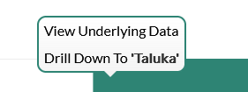
Dashboard
Progress Milestone

Slide 19
Dashboard
Work Status – “New” Schemes
Work Status – “Retro” Schemes

Slide 20
MS Project
Work in Progress Schemes

Slide 21
Sample Site Visit Photos

Slide 22
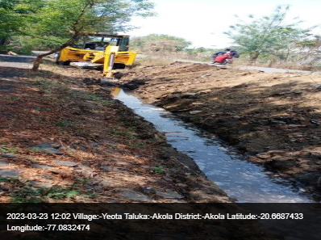
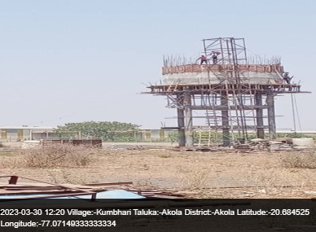
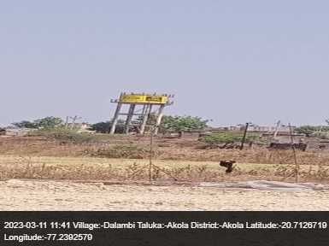
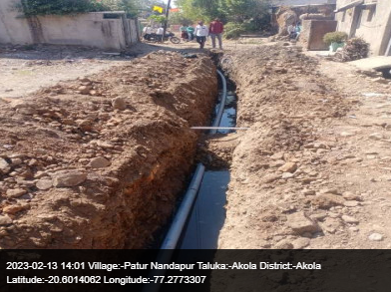
Taluka – Akola

Slide 23
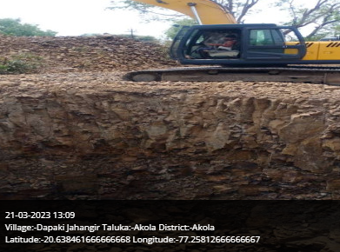
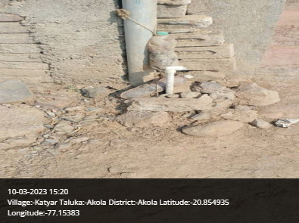
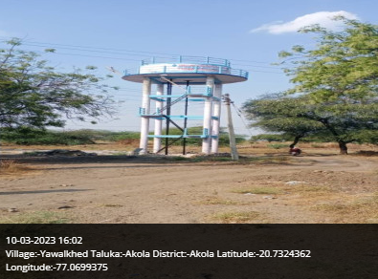
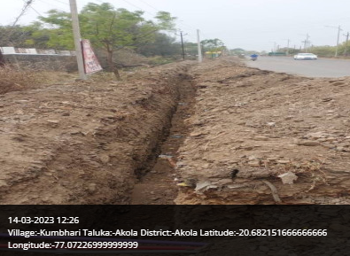
Taluka – Akola

Slide 24
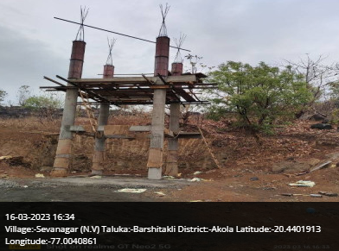
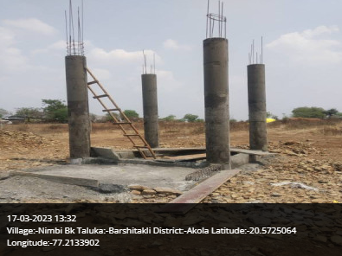
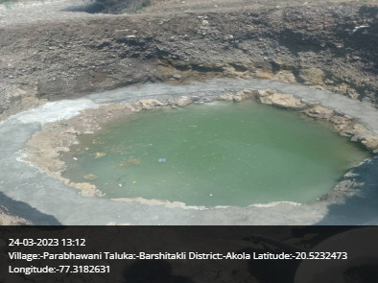
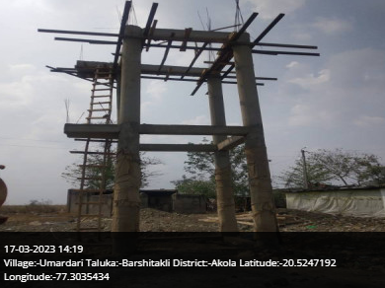
Taluka – Barshitakli

Slide 25
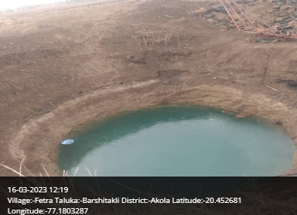
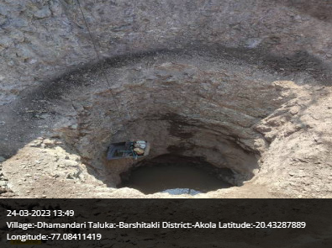
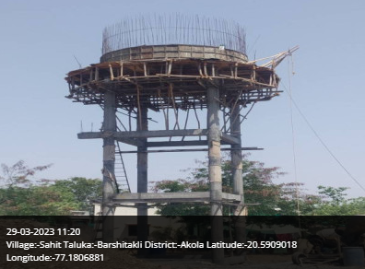
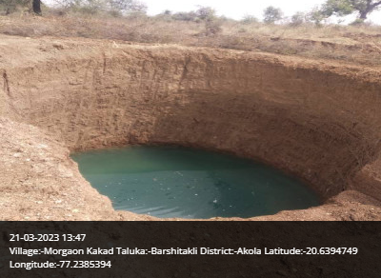
Taluka – Barshitakli

Slide 26
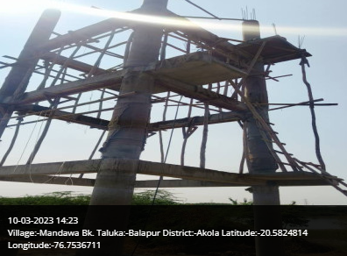
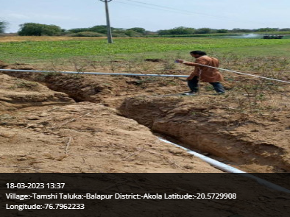
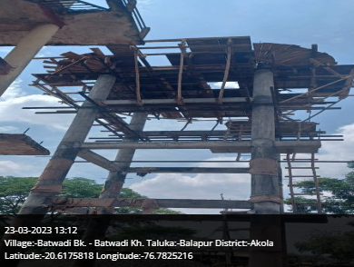
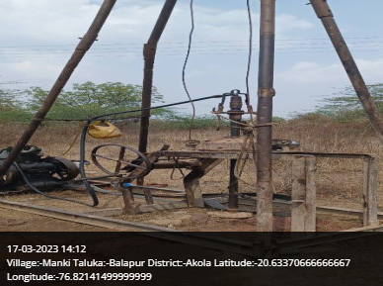
Taluka – Balapur

Slide 27
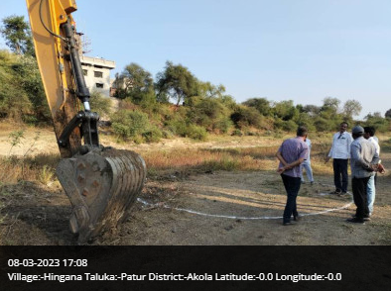
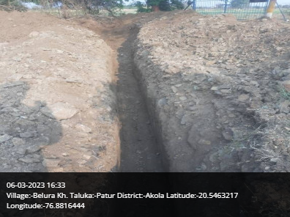
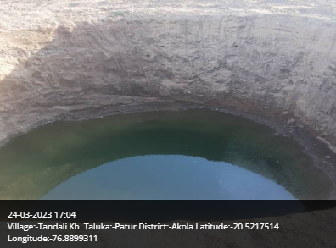
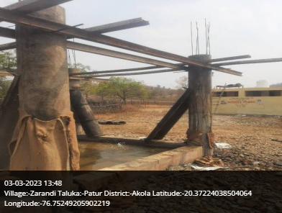
Taluka – Patur

Slide 28
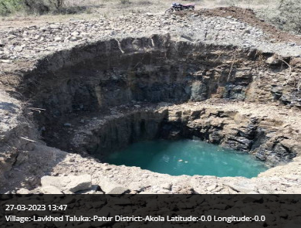
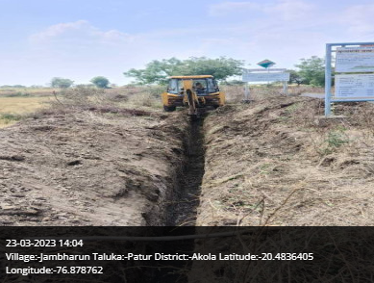
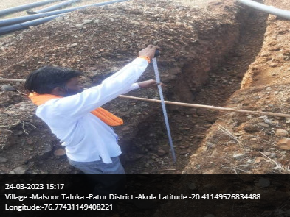
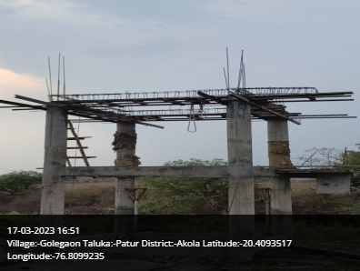
Taluka – Patur

Slide 29
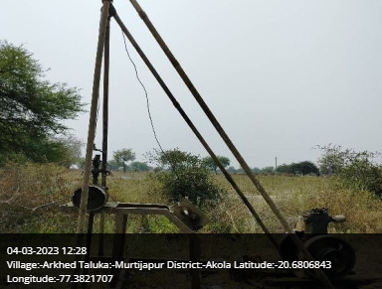
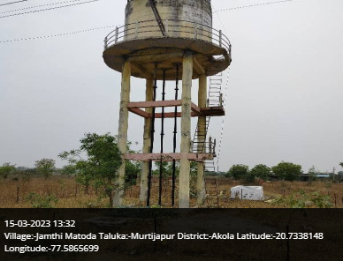
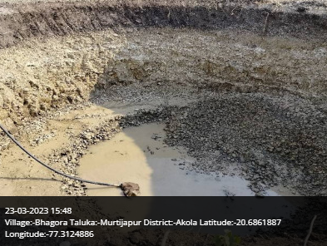
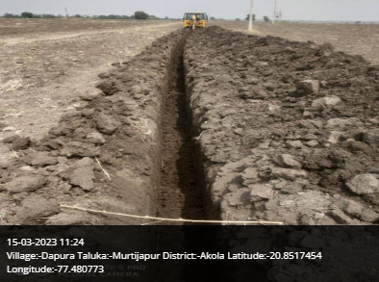
Taluka – Murtijapur

Slide 30
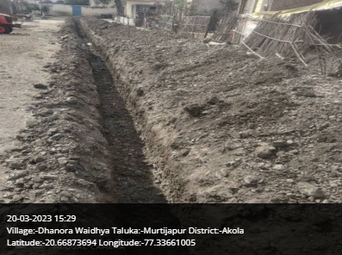
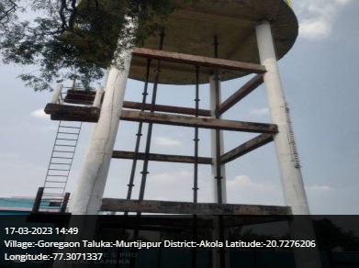
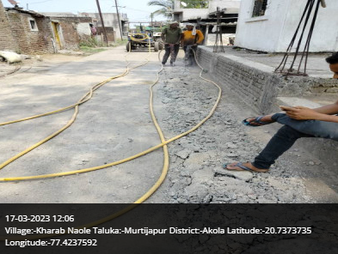
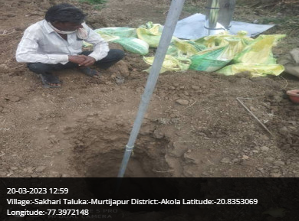
Taluka – Murtijapur

Slide 31

Thank You!

